Slide 1




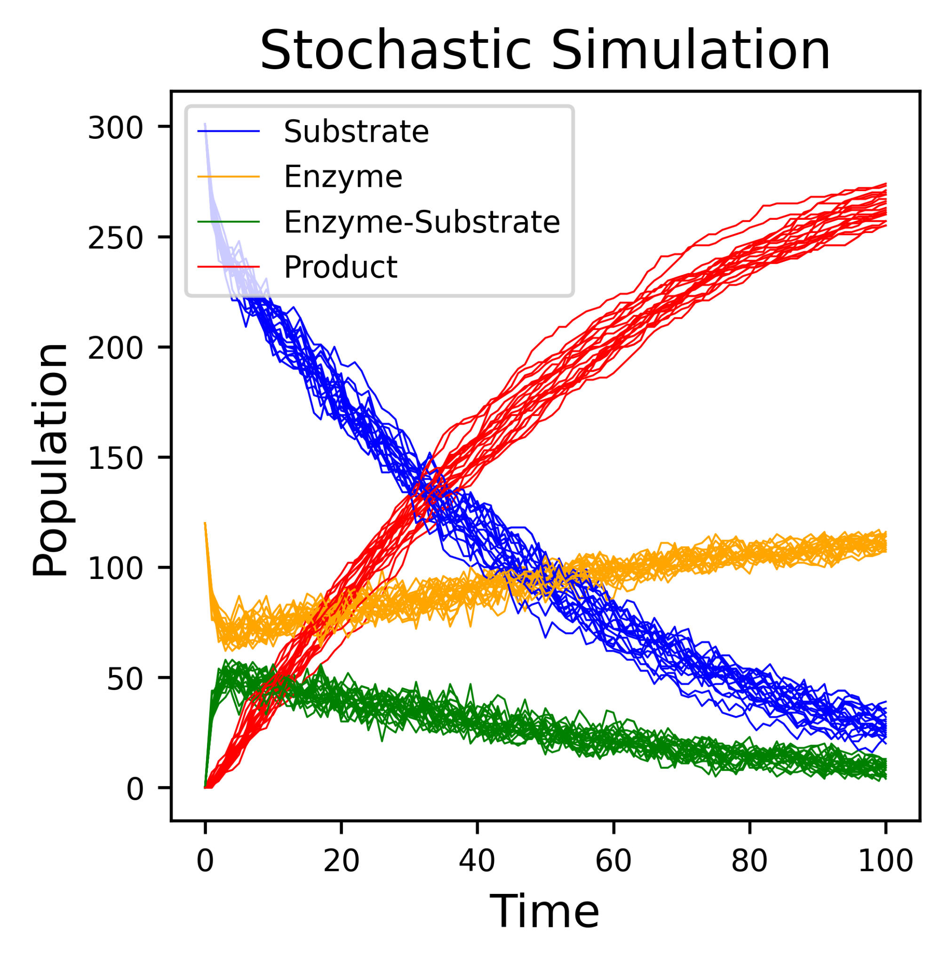
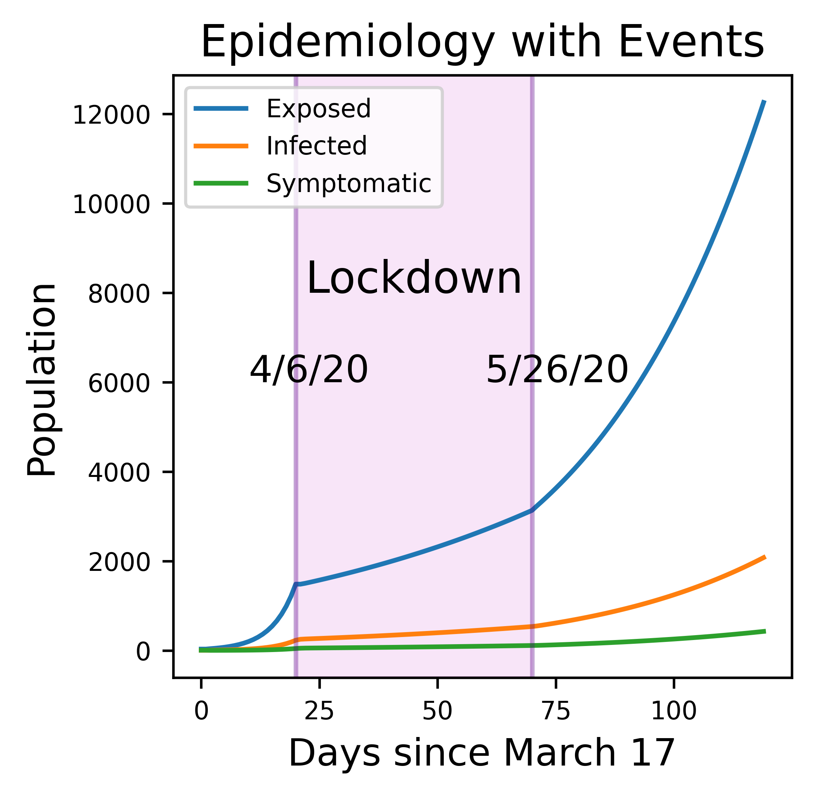
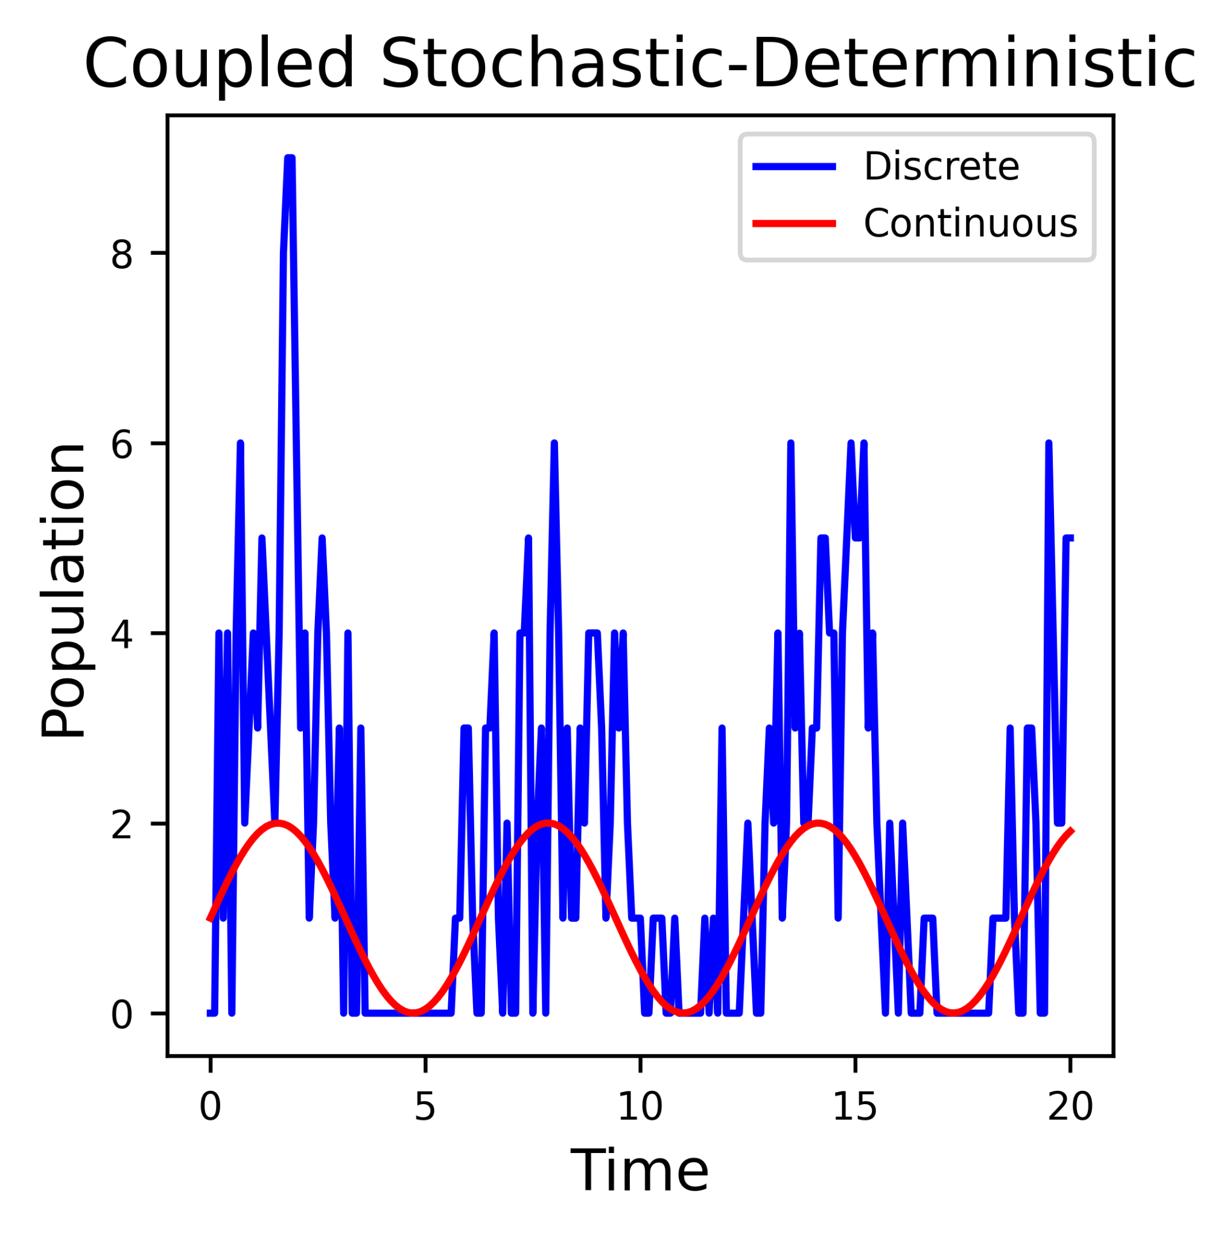
A
￼
Model
Model: setup the system
Variables / Species
Parameters / Constants
Reactions
Events, Rate Rules, more…
Timespan / frequency
￼
Run
Create
Simulation: type of computation
Deterministic / ODE
Stochastic / SSA
Hybrid: ODE + SSA
Pure Python & C++ implementations
User
Simulation
Plot / Data
Result: simulated data
data for one or more trajectories
Visualization
Plotly or Matplotlib
Pause/Resume
CSV output
Interpret
Results
B
C
D

